Slide 1

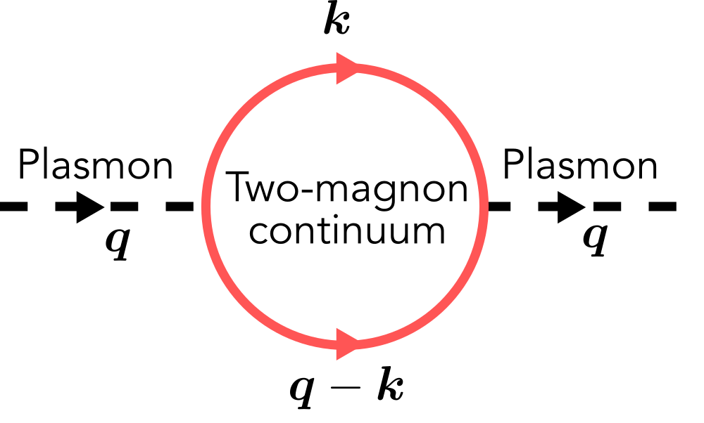


Coupling of plasmons to the two-magnon continuum in antiferromagnets
Plasmons couple to magnons in adjacent antiferromagnet
Coupling of plasmons to two-magnon continuum
One plasmon -> excites two magnons

